Slide 1

PERSONAL BRANDING
=Presented By
Kumar Kartikain Shivam
Notes:
This program will be about personal visibility. We’re taking a different cut at it.
Scientists in the room may be thinking, “this brand thing is too marketing oriented” Hang in here, we are talking about your personal impact and how inspired performance leads to inspired customers.

Slide 2

Objectives
What is Branding? Understand its importance in the fullest sense.
Understand your personal brand promise and how your distinct talent contributes to the strategic direction of your team and organization.
Design your personal brand to better distinguish your talent and contribution and to deliver inspired performance.
Notes:
3
Here are our objectives.

Slide 3

Agenda
What is Branding?
Understand your default brand and how you can develop your distinct brand promise.
Create your brand promise.
Formulate next steps to develop your distinct brand.
Notes:
4
Here are our objectives.
Customize to client if appropriate!

Slide 4

What is
a Brand?

Slide 5
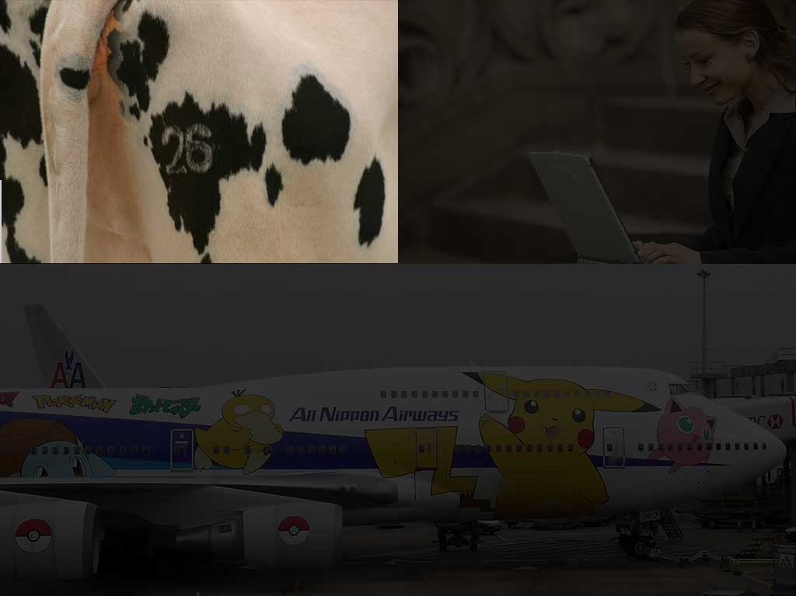
Agrarian: A Mark on Livestock

Slide 6
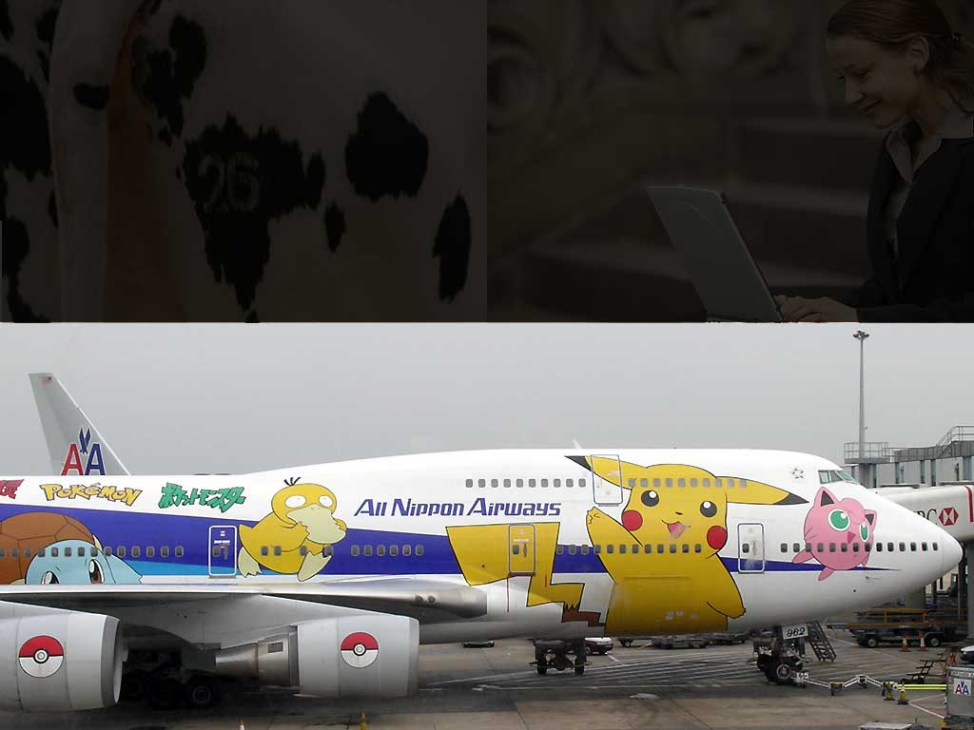
Industrial: Identifying Labels
on Products

Slide 7
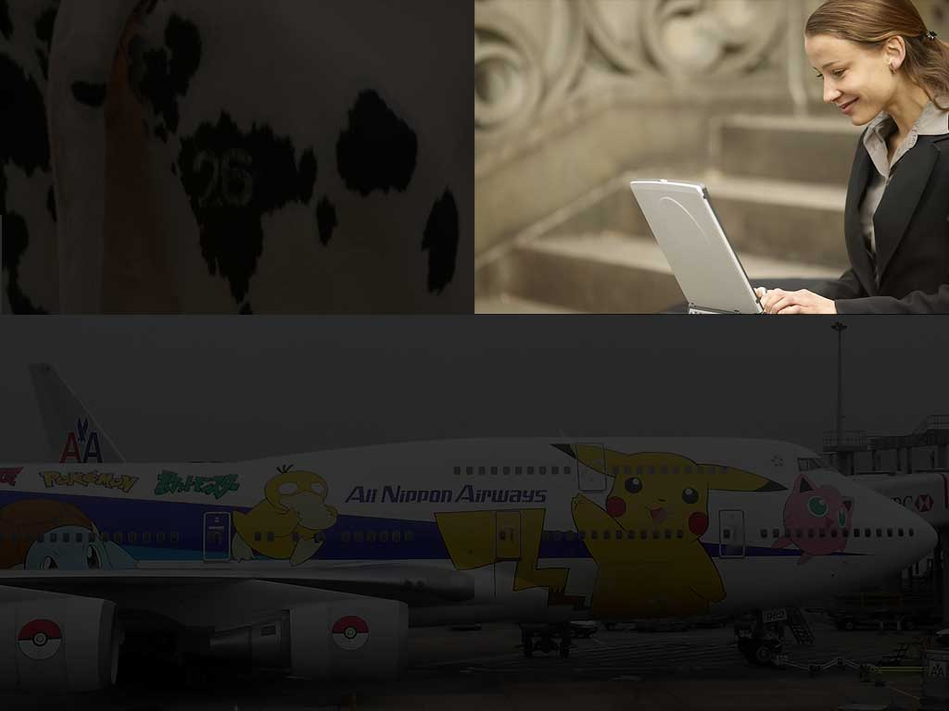
Information: An Extraordinary
Customer Experience

Slide 8

What is my distinct brand?
What do I want to be known for?
Notes:
1
This is just one of many questions we’ll be suggesting you use powerfully throughout this short program to make the best choices for yourself around your personal impact.

Slide 9
Your Life Experiences
You have a brand whether you are aware of it or not!
Your Point of View and Actions
The Way Others Perceive Your
Your Default Brand
Notes:
Introduce the concept of a “default brand” - i.e. the brand you currently have without thinking much about it. It just happens.

Slide 10
PERSONAL BRANDING
Personal branding is the process of defining and promoting what you stand for as an individual. Your personal brand is a culmination of the experiences, skills and values that differentiate you.
Notes:
5
At this point in the workshop people need to get up and move! Run the experiential exercise and make the point in setting it up that our experiences are a uniquely important part of our brand choices. This activity is designed to show the diversity and commonality of some of our experiences.

Slide 11
Five Tips to Brand Yourself
#1: Define your brand and become
an expert.
#2: Establish a presence.
#3: Generate brand awareness
through networking.
#4: Remember the 3 Cs of branding.
#5: Get feedback from those who
know you best—at work,
at home, anywhere.

Slide 12
Activity 1
Take your Pick
Choose your Favorite Brand from the images shown in the next slides
Notes:
5
At this point in the workshop people need to get up and move! Run the experiential exercise and make the point in setting it up that our experiences are a uniquely important part of our brand choices. This activity is designed to show the diversity and commonality of some of our experiences.

Slide 13


Notes:
6
For each set of logs we ask them to “CHOOSE!” and then ask why they chose -- fast and include as many responses as possible. Start to weave themes.
What Led You to Choose that Brand?
Any Other Reasons?
What Questions Do You Ask Yourself When Choosing?
Emphasize utility, history, consistency, quality, and how it leads to TRUST

Slide 14


Notes:
6
For each set of logs we ask them to “CHOOSE!” and then ask why they chose -- fast and include as many responses as possible. Start to weave themes.
What Led You to Choose that Brand?
Any Other Reasons?
What Questions Do You Ask Yourself When Choosing?
Emphasize utility, history, consistency, quality, and how it leads to TRUST

Slide 15


Notes:
6
For each set of logs we ask them to “CHOOSE!” and then ask why they chose -- fast and include as many responses as possible. Start to weave themes.
What Led You to Choose that Brand?
Any Other Reasons?
What Questions Do You Ask Yourself When Choosing?
Emphasize utility, history, consistency, quality, and how it leads to TRUST

Slide 16


Notes:
6
For each set of logs we ask them to “CHOOSE!” and then ask why they chose -- fast and include as many responses as possible. Start to weave themes.
What Led You to Choose that Brand?
Any Other Reasons?
What Questions Do You Ask Yourself When Choosing?
Emphasize utility, history, consistency, quality, and how it leads to TRUST

Slide 17
Debrief: Justify
What made you choose those Brands?
Why you feel connected to them?
What qualities do they possess?
What is their distinct contribution?
Are you proud or benefiting by relating to them?
Are you going to be associated with them in Future?
Notes:
Just like the choices we make concerning the products we buy, people are “taken off the shelf” for project teams and other opportunities.

Slide 18
“A great brand taps into emotions. Emotions drive most, if not all, of our decisions. A brand reaches out with a powerful connecting experience. It’s an emotional connecting point that transcends the product.”
Scott Bedbury, Nike/Starbucks
Notes:
It’s all about trust! The aspects of the branding concept that matter the most to trust are:
Authenticity and Integrity
Consistency and Reliability
Distinction
Excellence
What else?

Slide 19
What Makes a Brand Distinct?
Notes:
Link the power of the automatic choices the group so naturally made in choosing the brands they just did to the debrief of the exercise by getting people to explore this and other questions:
What makes a truly great brand?
What did making these choices show you?
Do your customers currently choose you the way you chose [nordstroms]?

Slide 20
Building Your Personal Brand
Commitment to Inventing a New Personal Brand
Accurate Perception of Current Default Brand
Notes:
Discuss the tension between current reality and the vision of the desired brand; how an accurate acknowledgement of the current state always resolves in favor of a compelling future.
The way it resolves is also connected to how we use our internal questions or Self-Qs. We call this natural process of how questions work powerfully behind our thinking QDAR, and the practical methods and tools of QuestionThinking™

Slide 21
Why: Perception is Everything
How
You
Are
People’s Perception
Your
Actions

Slide 22
Brand is Defined By
Consistency
Distinction
Excellence
Trustworthiness

Slide 23
“If there is nothing very special about your work, no matter how hard you apply yourself, you won’t get noticed and that increasingly means you won’t get paid much, either.”
Michael Goldhaber, Wired

Slide 24
Contribution/Talent Inventory
What are my aspirations?
What am I passionate about?
What are my special strengths?
What is my contribution to my work, my team, my organization, and it’s strategic goals?

Slide 25
ACTIVITY 2
Are YOU Distinct? or
Extinct?
Answer the Upcoming Questions to know
Notes:
Question: Why should we worry about this?
Answer: Because if you don’t work to make your brand promise live in every customer interaction or transaction you are vulnerable to a very serious disconnect in credibility -- or a “Don’t Do As We Say” culture, and customers will not stand for it.
Fed Ex, Disney, the Four Seasons, Southwest Airlines all understand and practice this important branding concept -- they all have formal and informal ways of immersing current and future employees in the brand promise, personality, characteristics, values, and most of all, behaviors. They encourage employees to embody their brands.

Slide 26

Why Do People Choose You?
For Projects? Teams?
For What Tasks?

Slide 27
Personal Brand Distinction
Who are the people that are always asked to be on project teams or to take on highly visible projects?
Why are they are consistently asked?
What qualities do they possess?
What is their distinct contribution?
Notes:
Just like the choices we make concerning the products we buy, people are “taken off the shelf” for project teams and other opportunities.

Slide 28
Four Descriptive Words
Think of what others might say about you to come up with at least 16 words.
Collect four distinct words from 4 - 6 people who know you and your work.
Reflect on feedback from any recent 360 or your last performance review.
Notes:
If you know anyone else in this room, including your mentor or mentee, go over to them and ask them to describe you with 4 words. If not, then think of feedback from your mentor, mentee, last review, any 360 feedback and come up with 16 words.

Slide 29

Debrief: In pairs, discuss…
Is there anything you think others missed or might miss?
Is there anything that might surprise you in what others have said?
Notes:
Tell the story of the person who canvassed others and found out her brand was being late. The issue of a label of being late is to be perceived as “unreliable.”

Slide 30

Your Brand?
Am I aware my default brand?
Do I like it?
How would I change it if I could?
What opportunities does it open or close for me?
Notes:
We then ask people if it’s OK with them.
Is that the brand they want? Is there anything missing?
Mention that these types of questions are ones we call “Self-Q’s.” They are the types of questions we ask ourselves in our thinking. We are often aware of these questions, but many times we are not.

Slide 31
Distinct Contribution/Talent
Have I received the highest Performance Review I could receive?
What areas do I want to develop?
If I fully developed myself in the areas I am committed to developing, how would people describe me?
Would this description match the sixteen distinct words from my current Default Brand?
What is the gap and the opportunity for development?

Slide 32
Your Brand Promise
Notes:
This is the first brand promise exercise. Participants use the workbook and construct one based on the words/phrases and then share it with a partner.
FORM IN WORKBOOK

Slide 33
Brand Promise
Personal Trademark?
What makes you distinct?
Tag Line?
Notes:
This is what we mean by brand promise. It’s what you can be counted on to deliver.

Slide 34
“You are the storyteller of your own life, and you can create your own legend or not.”
Isabel Allende, Author

Slide 35
Develop Your Brand Promise
Generate 16 Distinct Words/Phrases that Represent your Brand Commitment.
Use the 16 Words you Were Given or Make up Your Own.
This is an Iterative Process- a Work in Progress.
Follow your Dreams and Work Hard to Achieve them.
Notes:
Please share with one person, then another, then another. Listen to how you express your brand, does this sing for you/does it fit? Ask your partner for feedback about whether it feels right to them. It’s a work in progress.

Slide 36
“If you don’t invest in the brand as an asset like anything else, just like you would a factory, then you are going to lose market share and leadership. You have to maintain and replenish a brand over time.”
Don E. Schultz, Professor of Integrated Marketing Communications
Northwestern University

Slide 37




Types & Platforms of BRANDING
OFFLINE Branding
ONLINE Branding
Notes:
1
This is just one of many questions we’ll be suggesting you use powerfully throughout this short program to make the best choices for yourself around your personal impact.

Slide 38
Next Steps
Daily: Keep a log about recent meetings and presentations.
Have my actions enhanced my image of trustworthiness and credibility? Explicitly or implicitly?
Take the opportunity to ask more people to describe you – You will become clearer about your default brand.
Notes:
Think about the last meeting you were in and answer these questions.

Slide 39
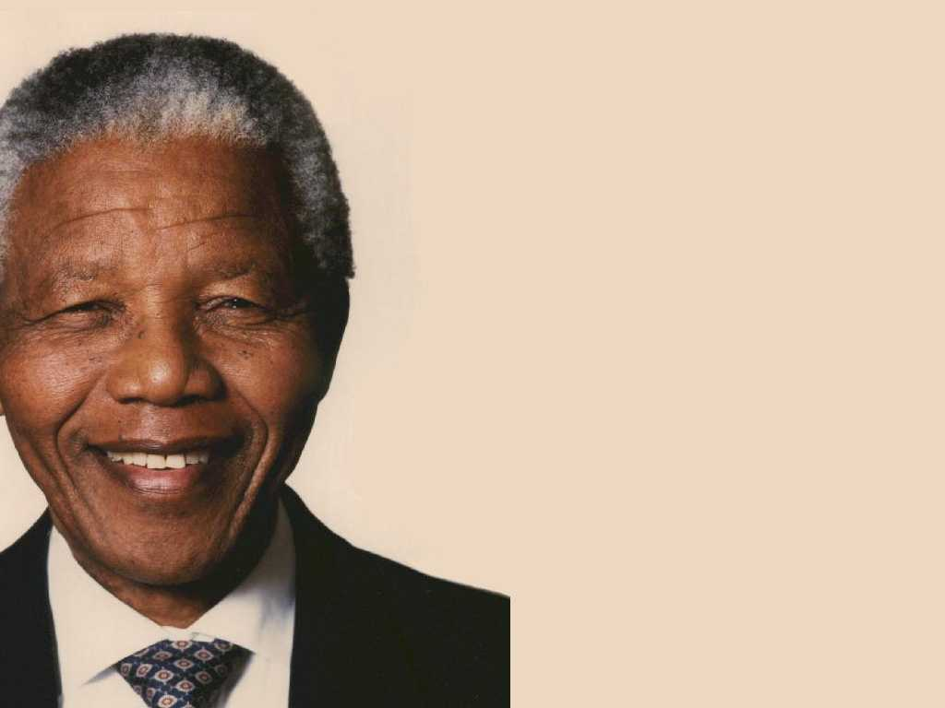
“Our deepest fear is not that we are inadequate. Our deepest fear is that we are powerful beyond measure.
It is our light, not our darkness that most frightens us.
We ask ourselves, who am I to be brilliant, gorgeous, talented, and fabulous? Actually, who are you not to be?”
Nelson Mandela
Notes:
A Cautionary tale...

